Slide 1

Machine Learning Assignment MSc in DS and AI

Slide 2
The Team
Akalanka Sakalasooriya
MSc/DSA/115
Udaya Kumara
MSc/DSA/109
Hashan Bandara
MSc/DSA/148

Slide 3
Presentation Overview
1
2
ML Model Development for Diabetes prediction
ML Model Development for Customers Loan Repayment Prediction

Slide 4





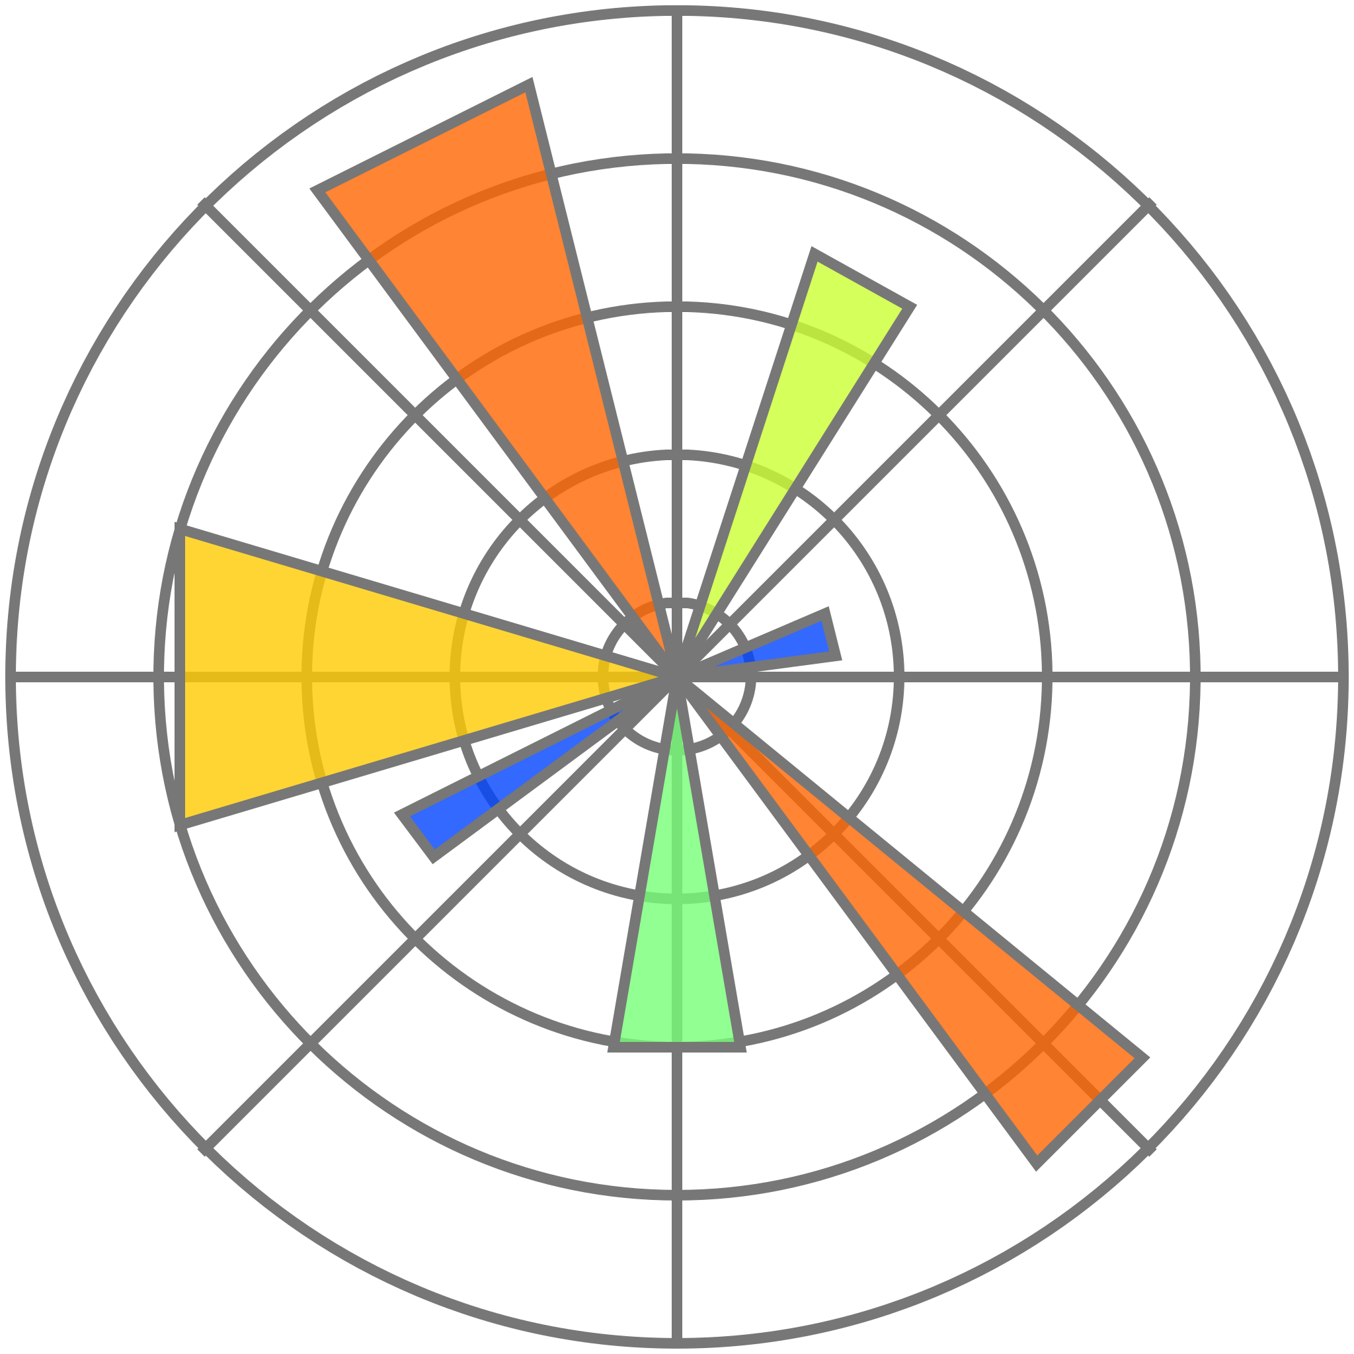

Technologies
Data pre-processing
Model Development
Visualization
Python
pandas
Scikit-learn
MLflow
Matplotlib
Source-code and
Project management
Git

Slide 5




Predicting Diabetes: A Data-Driven Approach
Preprocessing Steps
Feature Engineering
Model Selection and Development
Hyperparameter Tuning

Slide 6
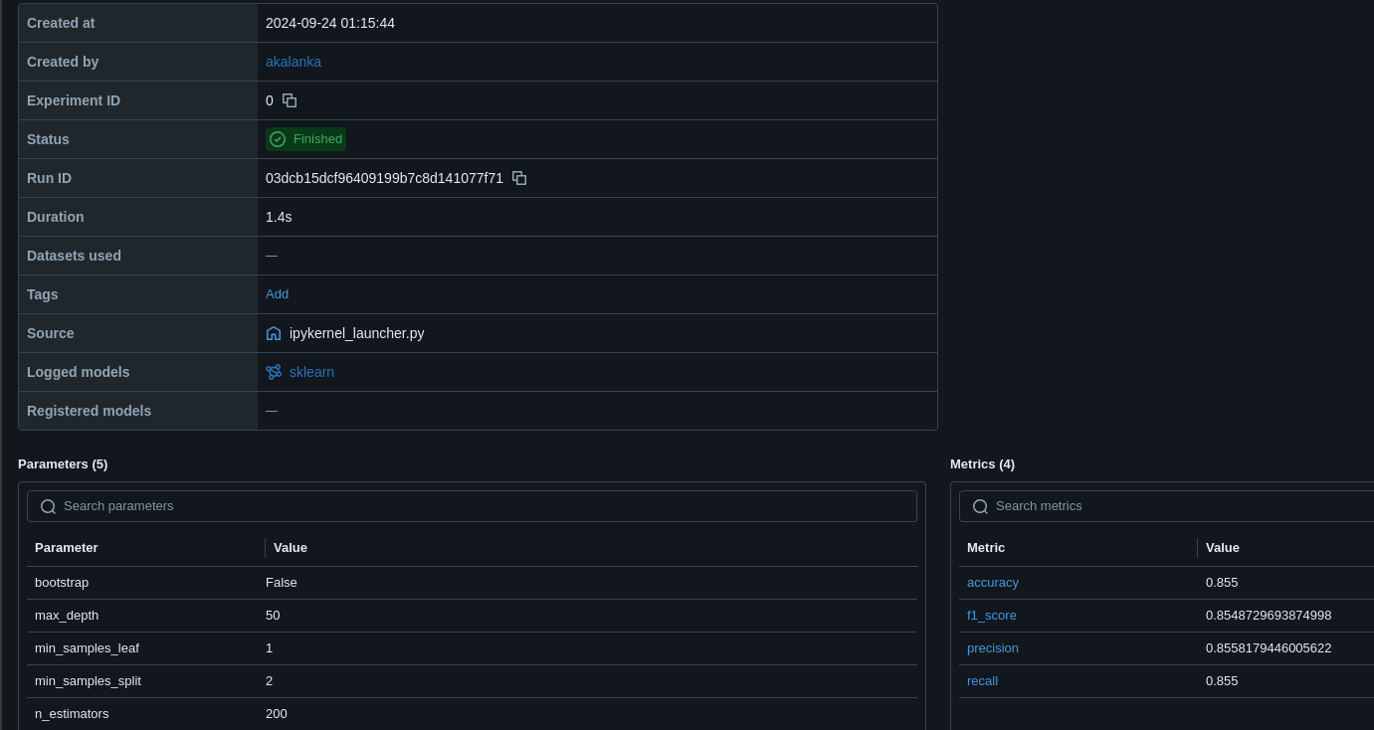
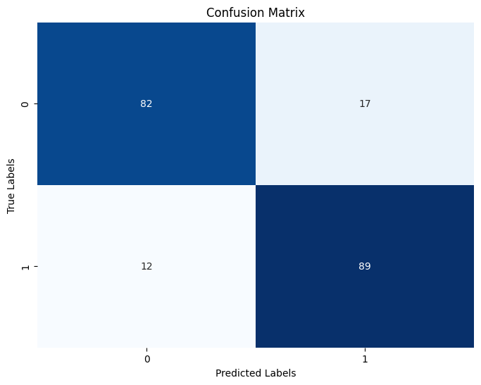

Slide 7
Loan Repayment Prediction: Insights from Data
Preprocessing Steps
Feature Engineering
Model Selection and Development
Hyperparameter Tuning

Slide 8
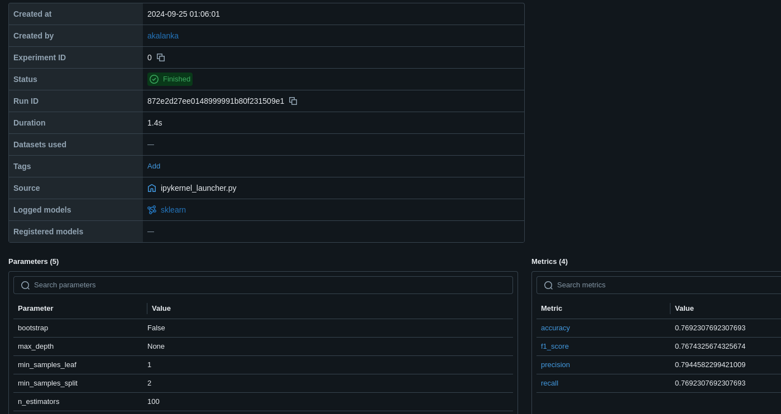
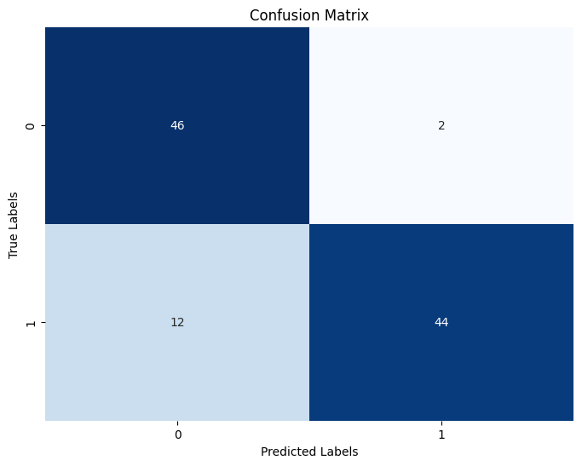

Slide 9
Thank You

Slide 10


Any Questions

